Slide 1


Skills Challenge
forstergroup.co.uk

Slide 2

SKILLS
The problem that never goes away….
…..not having enough people that have the right knowledge and skills
Notes:
World of work and world of learning has changed considerably
Lots to think about and as well all know we cannot solve our problems with the same level of thinking that created them
Skills & training is no different

Slide 3
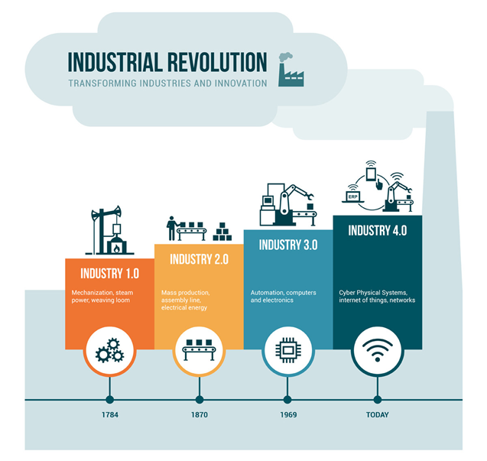
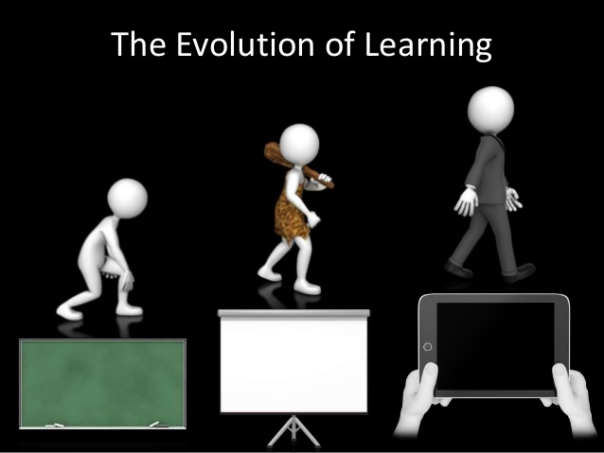
Context
Notes:
Business context
Learner context
Exceed expectations is easier that you may think

Slide 4

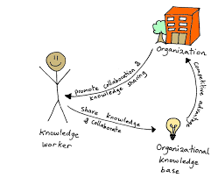
Productivity & performance
Notes:
In the main, most have moved on and recognise that our workforces are more complex that simple a set of resources to be deployed or scheduled
Successful organisations are knowledgeable
They are productive and profitability and they invest in work places and their people to deliver high performance

Slide 5
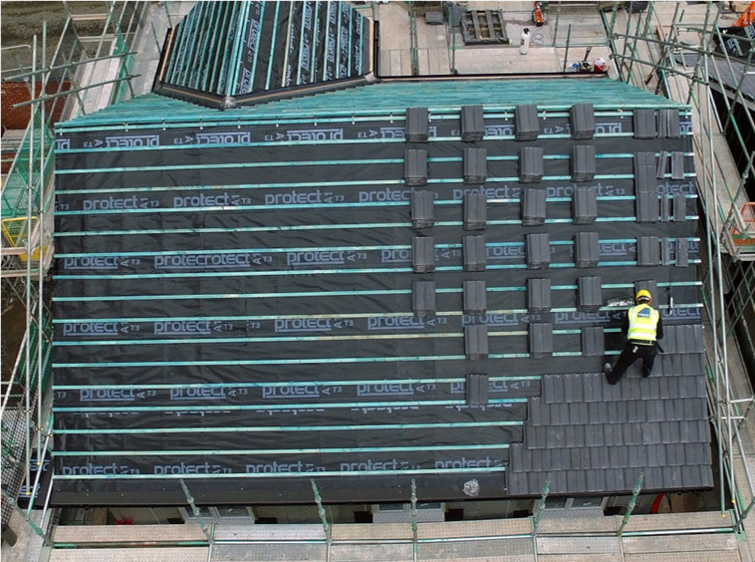

Forster
Notes:
FUTURE OF WORK
Forster Standard
Systems (ISO +)
Values
Productivity Initiative
Digital Transformation
Off Site
FUTURE OF SKILLS
Skills Academy
Construction Learning Centre
Integrated Services
New Pathways into Industry
Collaboration FE & Industry

Slide 6
An alternative approach
Craft Apprenticeship
4 year apprenticeship, competence was assessed in college
Excellent qualification for sectors such as repair & maintenance, domestic work
Did not meet business or sector requirements, key elements of the qualification were not relevant
Specialist Apprenticeship
2 year apprenticeship, competence assessed in the workplace and during off site training.
Contextualises the offsite learning and integrates this knowledge into practice on site throughout the duration of the apprenticeship
Residential program creates significant value add, developing individuals meta skills, their maturity, developing relationships, strong identify, sense of purpose and values

Slide 7
OBJECTIVES
Control the pipeline of talent into workforce to meet organisational requirements
Increase organisational capacity, performance and productivity
Standardise working practices across all of the workforce “Forster Standard”
Skills acquisition designed to meet organisational requirements and national qualifications
Off site learning will be technical but more importantly it will focus on developing individual meta skills
Competence will demonstrable and will be assessed in the workplace involving the wider teams
Contribution and achievement will be rewarded financially and non financially
To provide a sustainable and controlled form of investment

Slide 8
KEY DATES
2013/14 Developed 2 pilot projects with different Colleges, both pilots were terminated
2014 Industry Working Group established and Specialist Apprenticeship was developed for sector
2015 Skills Academy created, offsite learning delivered at Head Officer
2017 SQA Accreditation achieved, Skills Academy moves to Brechin Community Campus
Deliverables:
82% qualification achievement rate

Slide 9
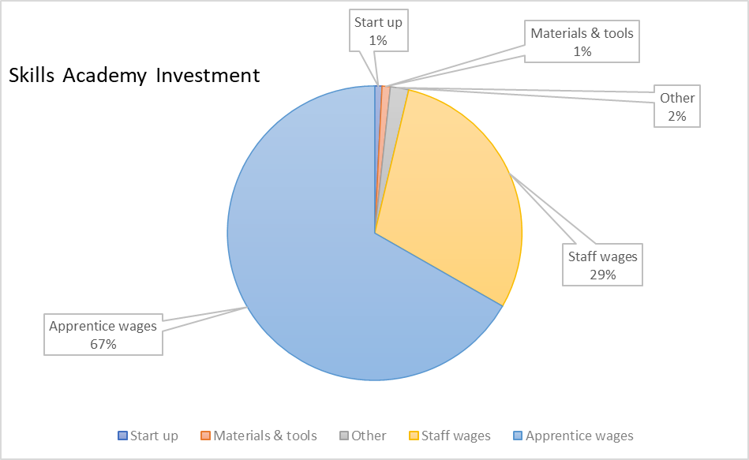
Investment

Slide 10
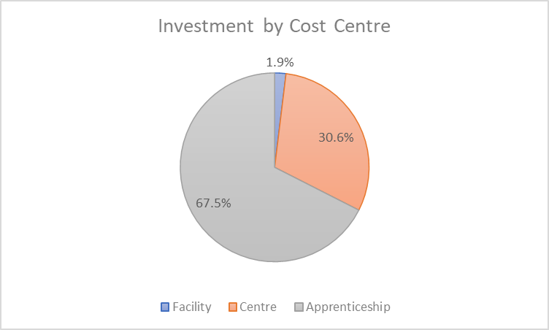
Investment & funding
24.9% of total investment offset by CITB grants related to the employment of apprentices and delivering training
CITB handled and provided the accommodation and travel expenses support for apprentices
Construction Learning Centre was utilised as part of a industry & school partnership collaboration which extended beyond the Skills Academy
Only one new colleague was recruited, the balance of staffing came from existing overhead
The apprentice wage costs were based on National Minimum Wage for the two year period

Slide 11
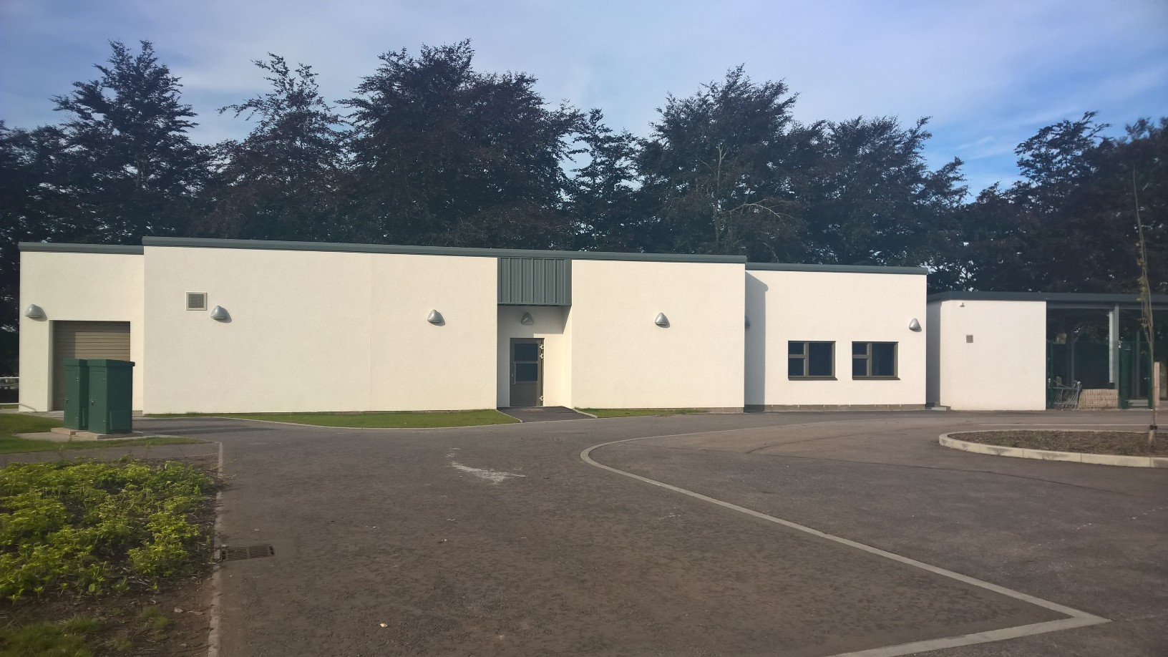

Brechin Community Campus Learning Centre
Notes:
Forster Skills Academy accredited SQA Centre
Resourced with a full time Trainer and Administrator
Control volume of employed apprentices with forward orders
Increase achievement and retention through recruitment, residential program and extra curricular activities
Ability to deliver a safer, efficient and productive service, transferring knowledge into practice on site
Aligned with ISO 9001, 45001, 14001 standards.
Sustainable, investing first to save later.
Purpose:
Provide a local hub and resources for learning in the construction and built environment.
Hub will support school learners, apprentices, private and public sector employees.
Pipeline of work in and around Angus will provide work placements and employment opportunities.
Secondary School Pupils
Design & Build Pilot S3 and S4 (target academic & vocational mixed group) (In progress)
Foundation Apprenticeships in Civil Engineering S5 and S6 (In progress)
Apprentices
Specialist Modern Apprentices – Roof Tiling in New Build (In progress)
Technician Modern Apprentices – Quantity Surveying & Estimating
Graduate Apprentices – Civil Engineering
Industry & Public Sector
Technical, compliance and CPD training
Construction Learning Centre purpose
Provide a local hub and resources for learning in the construction and built environment.
Hub will support school learners, apprentices, private and public sector employees.
Pipeline of work in and around Angus will provide work placements and employment opportunities.

Slide 12
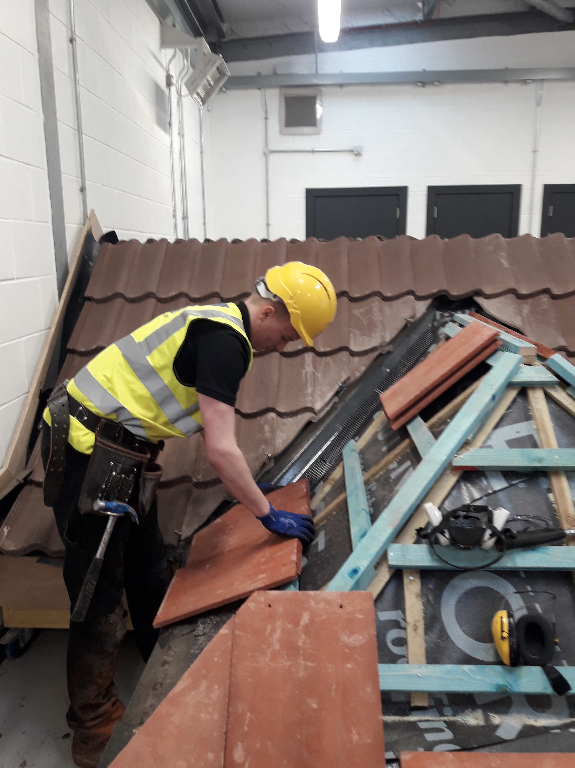
All rigs are designed to meet the qualification but critically apprentices are trained to the Forster Standard
Rig specification sheets match Site Specification Sheets
All products and fixings are used to meet standard

Slide 13
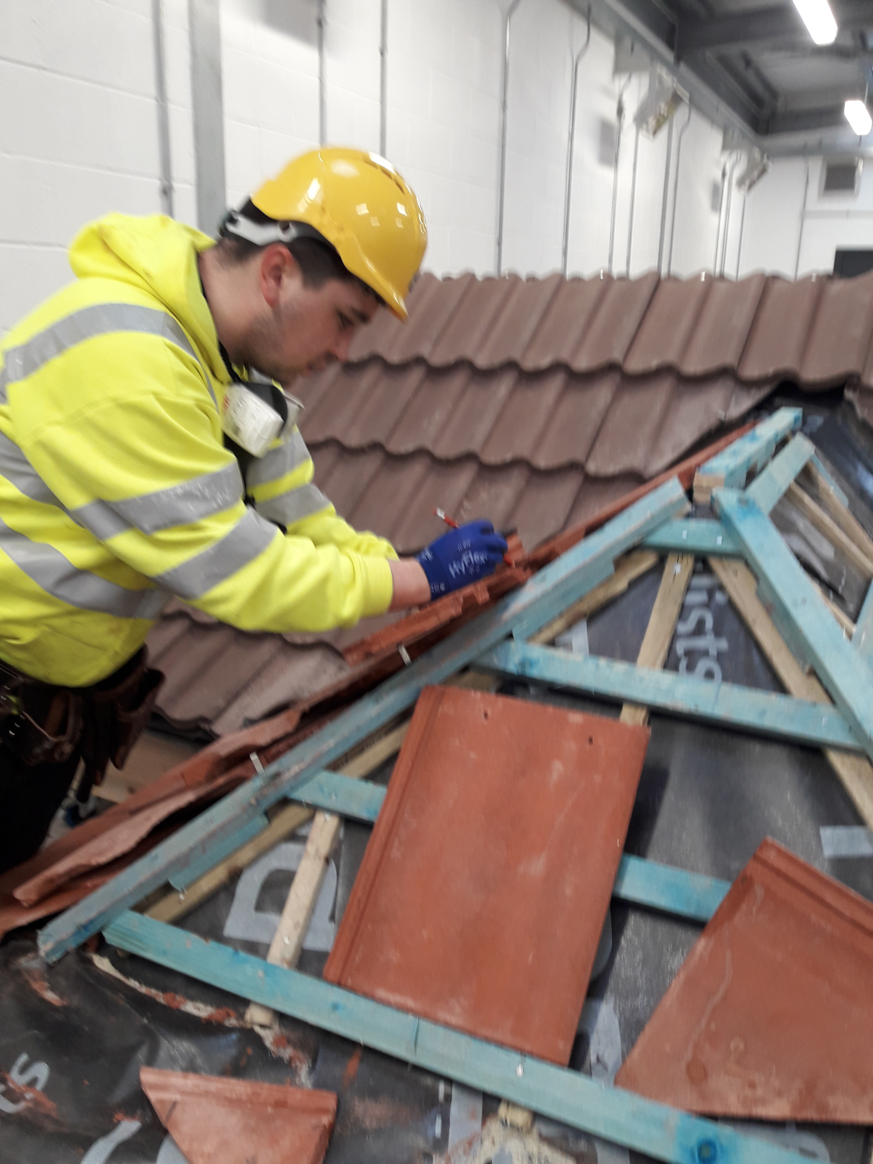
It can be daunting….
Care is taken to understand individual learning needs and what work activities they do on site
It’s a team effort in year one to ensure that the offsite is delivered onsite to bed in the knowledge

Slide 14
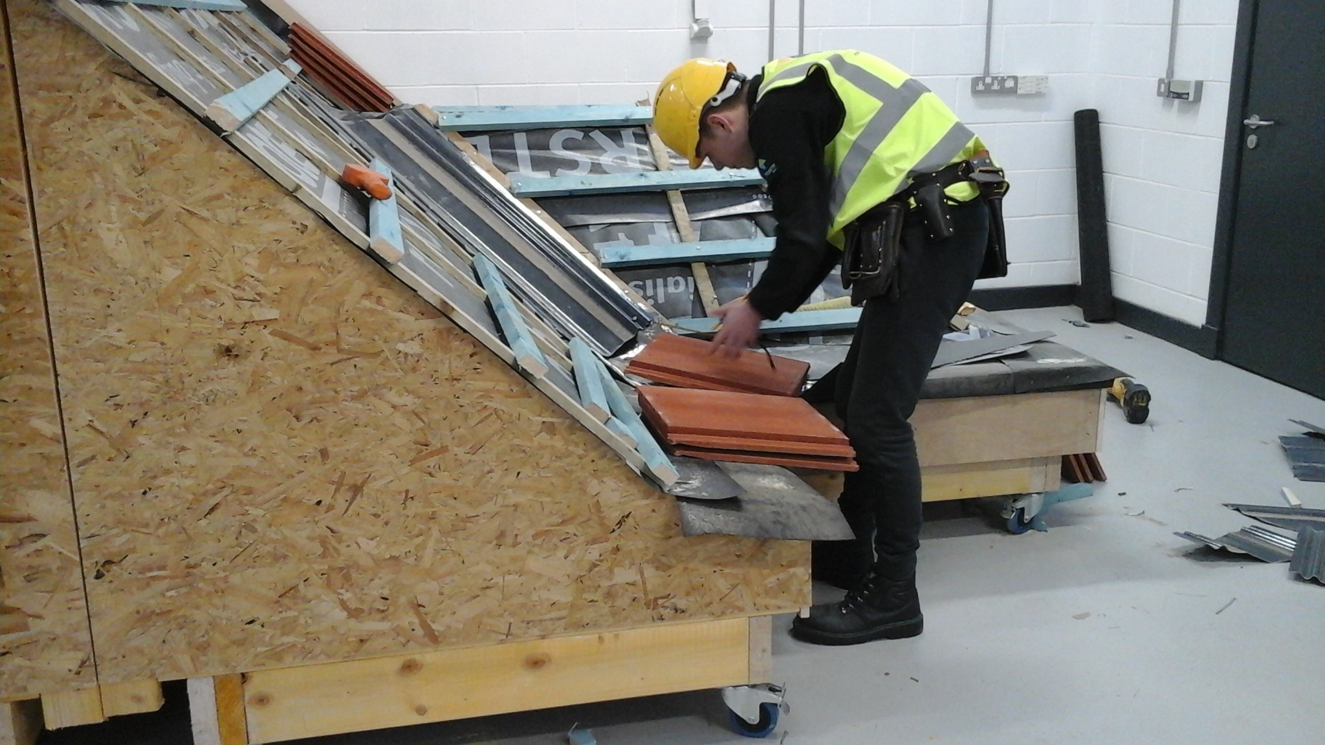
Each apprentice has a rig and work at their own pace with support
Trainer to learner ratio 1:6

Slide 15
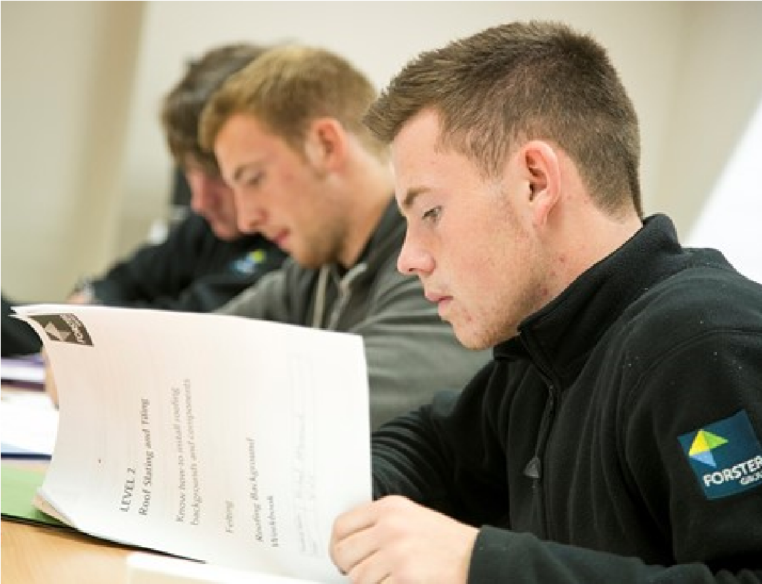

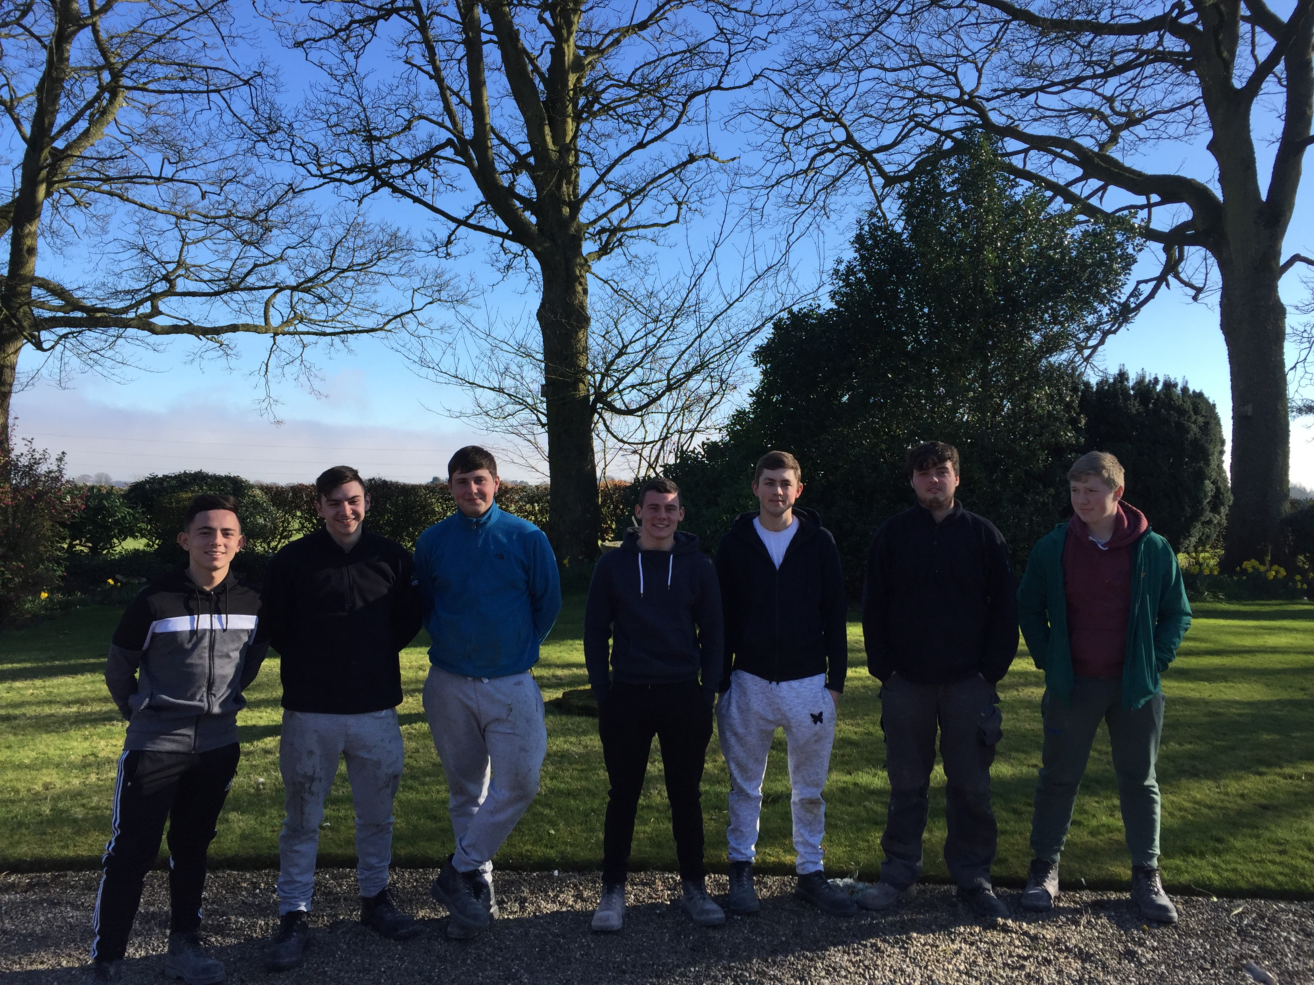
Cattle & Arable farm visit, is a popular night class and an interesting intro to another industry
Core skills, rebuilding confidence in the classroom, contextualising the learning to apply to common work day tasks.

Slide 16
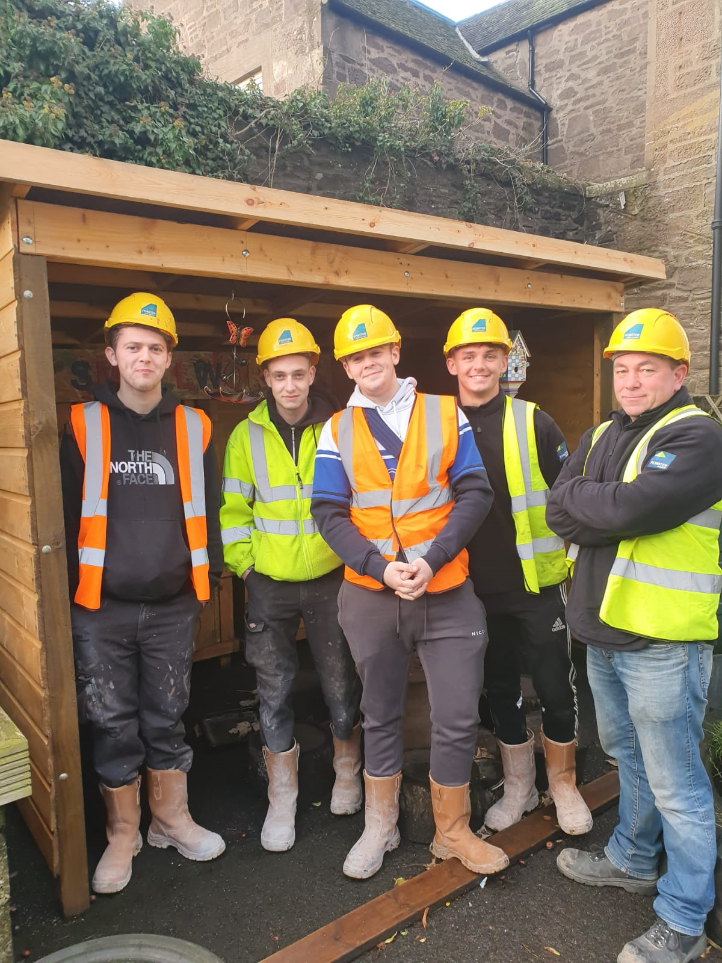
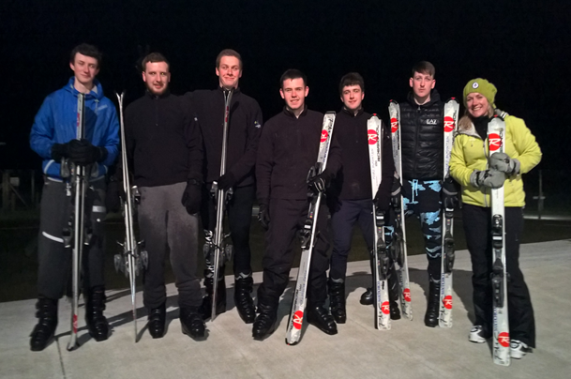
On residential, one night class is recreational and the other is classroom based. Glen Esk is a favourite for evening hikes
Apprentices are always supporting local community activities

Slide 17
Organisational knowledge

Slide 18
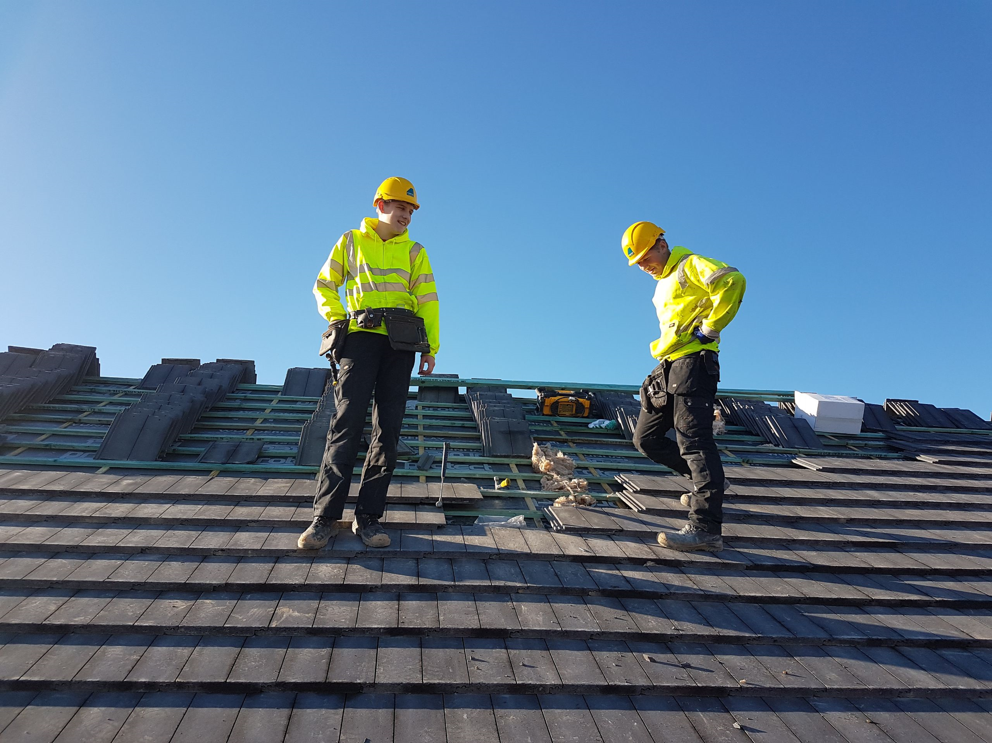
Integrating knowledge into practice
Embedding knowledge from offsite learning into practice on site ….
Tradesmen/Mentor
SA Coordinator
Site Workbook
Trainer Site Review
Director Site Review
CITB Site Review

Slide 19
What do the apprentices say?
Each apprentice group deliver a presentation as part of their apprenticeship often to visiting distinguished guests, including MSPs, MPs, clients and community partners where they are able to share their story in their own words, which is most often through pictures!
The feedback from our apprentices about their learning experience is always excellent ………..
“My time at the Forster Skills Academy has been brilliant I have learnt a lot about Roofing, and also done fun things like skiing and team building challenges. I would highly recommend it.” Derrin Mackenzie
“I really liked my time at the Forster college learning new skills and meeting new friends, also had fun working with my tradesman onsite. I really enjoyed the experience” Liam Green

Slide 20
Any questions?
For more information about our Forster Skills Academy please get in touch
enquiries@forstergroup.co.uk
01356 628560

